Slide 1
Axis Insurance
Business Statistics of Axis Insurance Users

Slide 2
Objective
To find insights of the users of Axis Insurance
To prove if medical claims made by smokers is greater than non-smokers
To prove if BMI of females is different from males
To see if the proportion of smokers are significantly different across regions
To see if the mean BMI of women with no children, one child and two children are the same

Slide 3
Data Dictionary
Variable | Description
Age | Age of the primary beneficiary below 64 years old
Sex | Sex/gender (male/female)
BMI | Indicator of how over or underweight a person is
Children | Number of children/dependents covered by the plan
Smoker | Yes/No indicating if the insured regularly smokes tobacco
Region | Region of residence – northeast, southeast, southwest, northwest
Charges | Individual medical costs billed to health insurance

Slide 4
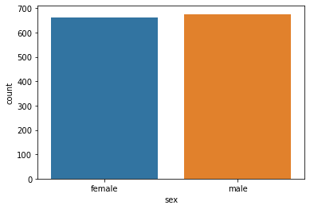
Exploratory Data Analysis – Gender Count
The number of female and male customers are about the same
Female : 662
Male : 676

Slide 5
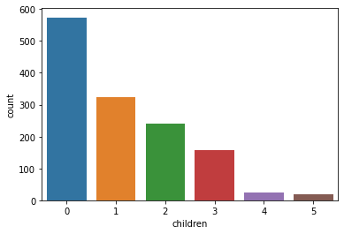
Exploratory Data Analysis – Children/Dependent
43% of the customers have 0 children
24% of the customers have 1 child
18% of the customers have 2 children
12% of the customers have 3 children

Slide 6
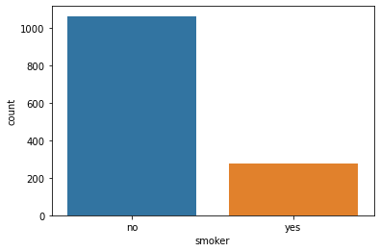
Exploratory Data Analysis – Smoker
80% of the customers regularly smokes tobacco

Slide 7
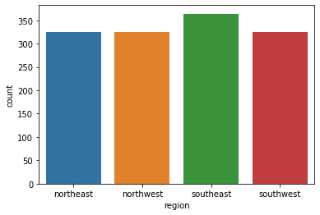
Exploratory Data Analysis – Region
There are slightly more customers who live on the Southeast region.
The distribution of customers based on region are almost equal.

Slide 8
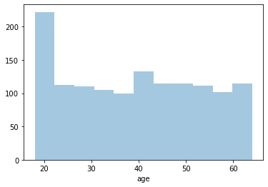
Exploratory Data Analysis – Age
The distribution of customers by age seemed to be almost uniform, with more customers with the age of 20 years old.

Slide 9
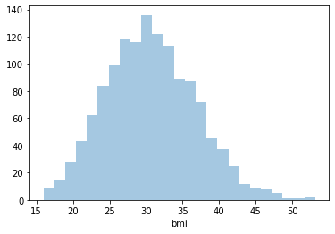
Exploratory Data Analysis – BMI
BMI of customers seem to be normally distributed

Slide 10
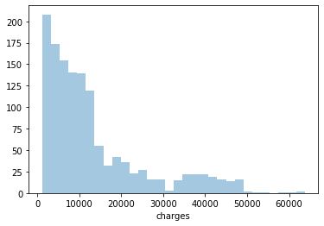
Exploratory Data Analysis – Charges
The histogram for charges seem to be right skewed.

Slide 11
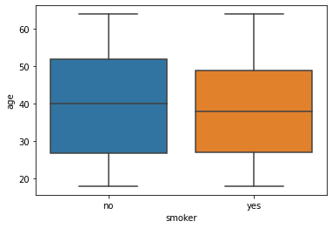
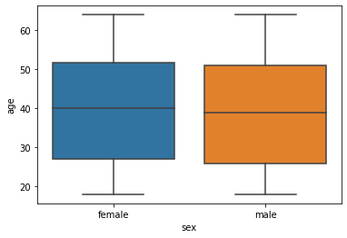
Multivariate Exploratory Data Analysis – Age
No seemingly significant trend can be seen

Slide 12
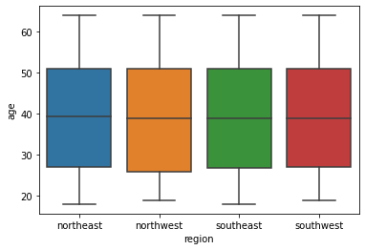
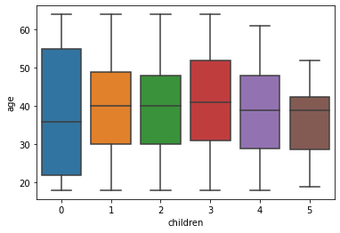
Multivariate Exploratory Data Analysis – Age
No seemingly significant trend can be seen

Slide 13
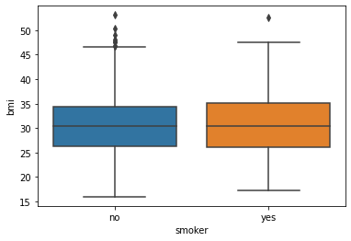
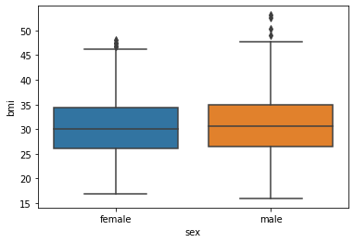
Multivariate Exploratory Data Analysis – BMI
No seemingly significant trend can be seen

Slide 14
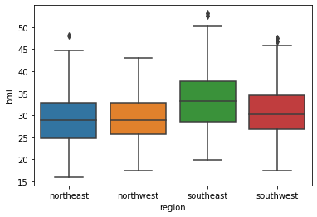
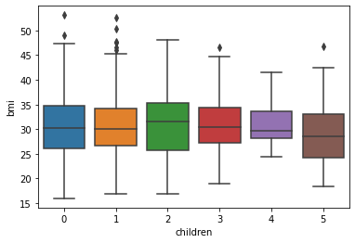
Multivariate Exploratory Data Analysis – BMI
BMI of customers on southeast region are slightly higher compared to other regions

Slide 15
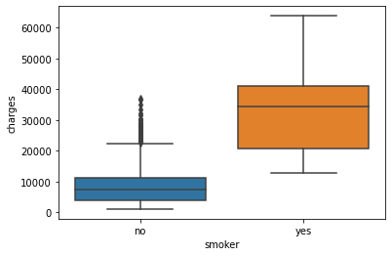
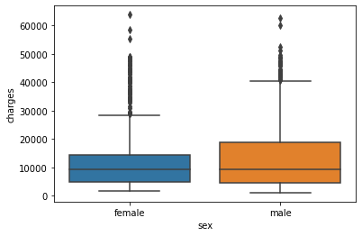
Multivariate Exploratory Data Analysis – Charges
Smokers have higher charges than non-smokers

Slide 16
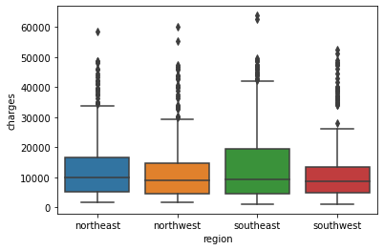
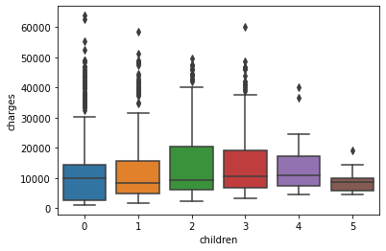
Multivariate Exploratory Data Analysis – Charges
No seemingly significant trend can be seen

Slide 17
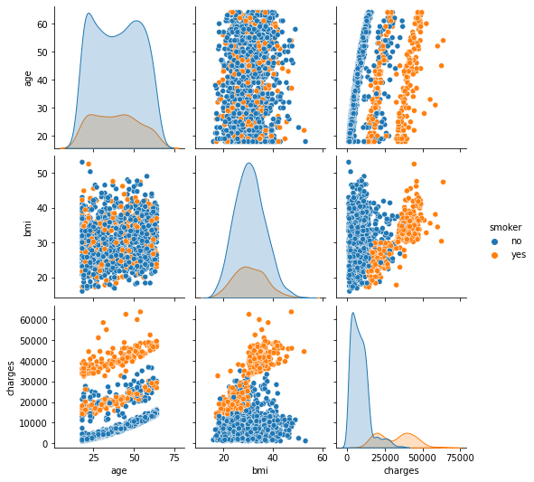
Multivariate Exploratory Data Analysis – based on Smoker
Age and charges seem to positively correlate, with three groups. The group with the highest charge has only smokers, while the group with the lowest charge has only non-smokers in it.
BMI and charges for smokers seem to correlate positively.
Smokers tend to have more charges than non-smokers.
The smokers in the data are young people who are less than 30 years old, and who have BMI of 25 and below.

Slide 18
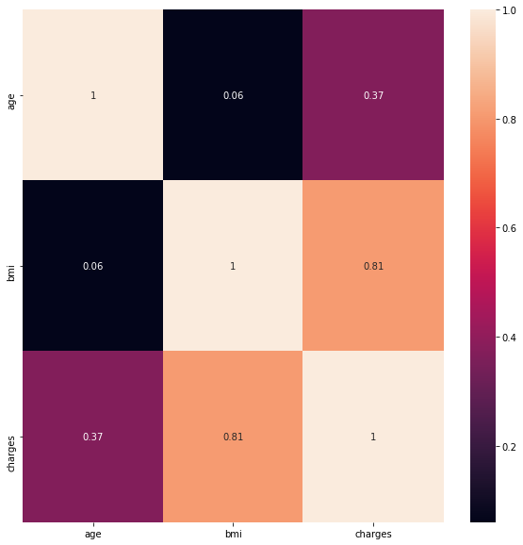
Multivariate Exploratory Data Analysis – Smokers
The correlation matrix proved that BMI and charges correlate greatly while age and charges somewhat correlates.

Slide 19
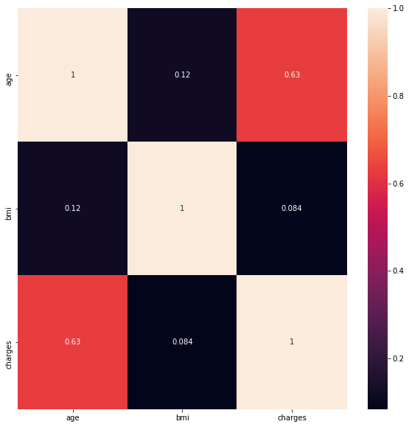
Multivariate Exploratory Data Analysis – Non-smokers
The correlation matrix proved that age and charges correlate well.

Slide 20
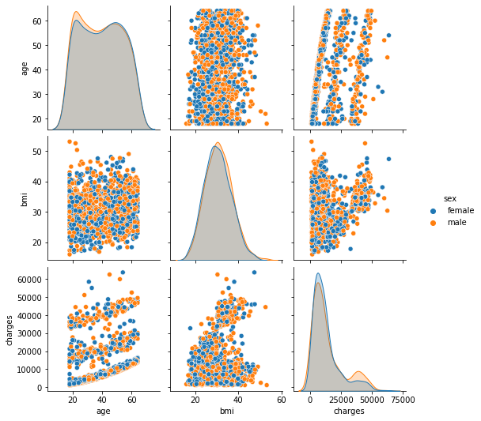
Multivariate Exploratory Data Analysis – based on Sex
No significant difference of data can be found between the two genders.

Slide 21
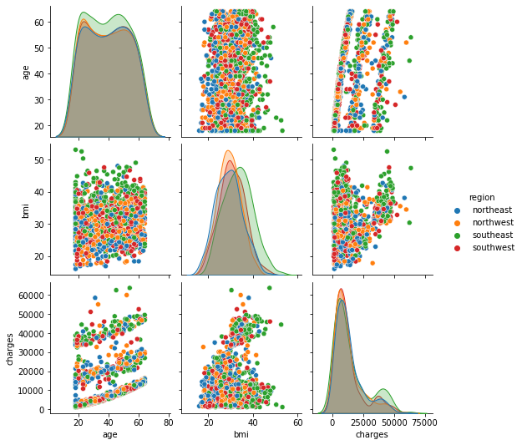
Multivariate Exploratory Data Analysis – based on Region
No significant difference of data can be found across different regions.

Slide 22
Exploratory Data Analysis - Insights
The male and female ratio of the customers are about 50:50.
Most of the customers have 0 children, with 43% of them.
Almost 80% of the customers are non-smokers.
The region of the customers are almost equally spread, with slightly more of them staying at the southeast region.
The BMI of the customers seem to be normally distributed, as there are no skews.
The BMI of the customers on the southeast region are somewhat higher on average compared to customers from other regions.
The histogram for charges is right skewed.

Slide 23
Exploratory Data Analysis - Insights
Smokers have higher charges than non-smokers.
The distribution of customers by age seemed to be almost uniform, with more customers with the age of 20 years old.
Age and charges seem to positively correlate, with three groups. The group with the highest charge has only smokers, while the group with the lowest charge has only non-smokers in it. The other group has a mixture of smokers and non-smokers.
BMI and charges for smokers seem to correlate positively.
The smokers in the data are young people who are less than 30 years old, and who have BMI of 25 and below.

Slide 24
Recommendations
To save cost, we can stop providing insurance to smokers. This is because the charges made are more expensive, especially for those who have high BMI
It is good to market insurance for young people, especially around 20-30 years old, as many of our customers are from that age range.

Slide 25
Are medical claims made by smokers greater than non-smokers?
Test Used : Two Independent Sample T-test for Equality of Means - Unequal Std Dev

Slide 26
Hypothesis Formulation
Null Hypothesis
𝐻0 : µ1 = µ2
Alternate hypothesis
𝐻𝑎 : µ1 > µ2
where µ1 is medical claim for smoker and µ2 is medical claim for non-smoker

Slide 27
Reason of Method Selection
It is found that the standard deviation between smoker data and non-smoker data are different
Sample size for each category is more than 30, hence normal distribution can be assumed
Charges data is continuous
Data between smokers and non-smokers are independent
Population mean and standard deviation are unknown

Slide 28
Insight
After the statistical test is being run, we found out that we can reject null hypothesis. Hence, the medical claim for smokers is greater than non-smokers.

Slide 29
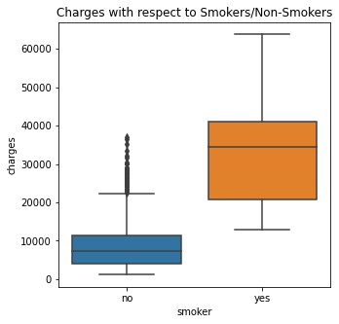
Insight

Slide 30
Is BMI of females different from that of males?
Test Used : Two Independent Sample T-test for Equality of Means - Equal Std Dev

Slide 31
Hypothesis Formulation
Null Hypothesis
𝐻0 : µ1 = µ2
Alternate hypothesis
𝐻𝑎 : µ1 ≠ µ2
where µ1 is BMI of females and µ2 is BMI of males

Slide 32
Reason of Method Selection
It is found that the standard deviation between female and male data are similar
Sample size for each category is more than 30, hence normal distribution can be assumed
BMI data is continuous
Data between female and male are independent
Population mean and standard deviation are unknown

Slide 33
Insight
After the statistical test is being run, we found out that we cannot reject null hypothesis. Hence, we can’t prove that BMI of females is different from that of males.

Slide 34
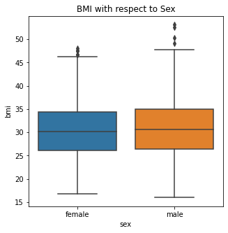
Insight

Slide 35
Is the proportion of smokers significantly different across regions?
Test Used : Chi-Square Test for Independence

Slide 36
Hypothesis Formulation
Null Hypothesis
𝐻0 : Proportion of smokers are independent across regions
Alternate hypothesis
𝐻𝑎 : Propertion of smokers are not independent across regions

Slide 37
Reason of Method Selection
Categorical variables are being compared
The expected value of the number of sample observations in each level of the variable is at least 5
Random sampling Is done, as per data provided

Slide 38
Insight
After the statistical test is being run, we found out that we cannot reject null hypothesis. Hence, we found out that the proportion of smokers is independent across regions.

Slide 39
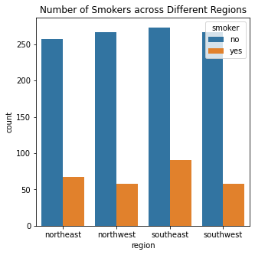
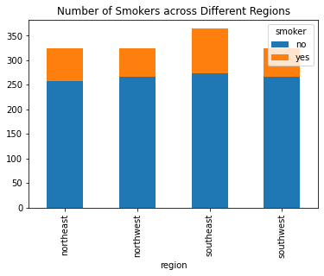
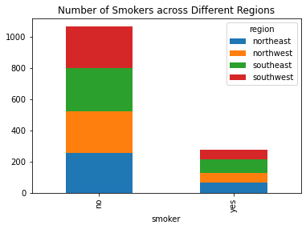
Insight

Slide 40
Is the mean BMI of women with no children, one child and two children the same?
Test Used :ANOVA

Slide 41
Hypothesis Formulation
Null Hypothesis
𝐻0 : 𝜇1=𝜇2=𝜇3
Alternate Hypothesis
𝐻𝑎 : At least one mean BMI level for woman with a number of children is different from the rest (for women with children of 0 to 2).
where 𝜇1 is mean BMI of women with no children, 𝜇2 is mean BMI of women with one child, and 𝜇3 is mean BMI of women with two children

Slide 42
Reason of Method Selection
There are three groups of data that will be compared.
Population variances are found to be equal.
The data samples are independent simple random variables.
ANOVA can tolerate violations to normality assumption

Slide 43
Insight
After the statistical test is being run, we found out that we cannot reject null hypothesis. Hence, we found out that the mean BMI of women with no children, one child, and two children are the same.

Slide 44
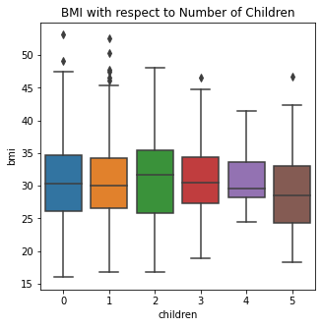
Insight

